Slide 1
Word2Vec and Word embeddings
Alex Dimakis @AlexGDimakis
Nikolaos Vasiloglou @vasiloglou

Slide 2
Continuous Bag of Words (Mikolov et al. 2013)
`For a successful technology, reality must take precedence over public relations, since nature cannot be fooled..’
`.. since nature ***** be fooled..’
y1
y2
y3
…
y_{V}
y
x1
x2
..
x_{Y}
h1
h2
..
h_{N}
Context
W
W’
Current word
One hot-encoded of previous word

Slide 3
Continuous Bag of Words (Mikolov et al. 2013)
Each row of W is a vector representation of a word v_{p}^{T}
Score for next word = u_{j}^{T} h
Where u_{j} is the jth column
of W’
x1
x2
..
x_{Y}
y1
y2
y3
…
y_{V}
h1
h2
..
h_{N}
W
W’
One hot-encoded of previous word

Slide 4
Continuous Bag of Words (Mikolov et al. 2013)
Each row of W is a vector representation of a word v_{p}^{T}
Score for next word = u_{j}^{T} h
Where u_{j} is the jth column
of W’
Then us softmax to obtain the posterior distribution on words:
y1
y2
y3
…
y_{V}
y
x1
x2
..
x_{v}
p1
p2
p3
…
p_{V}
h1
h2
..
h_{N}
W
W’
One hot-encoded of previous word

Slide 5
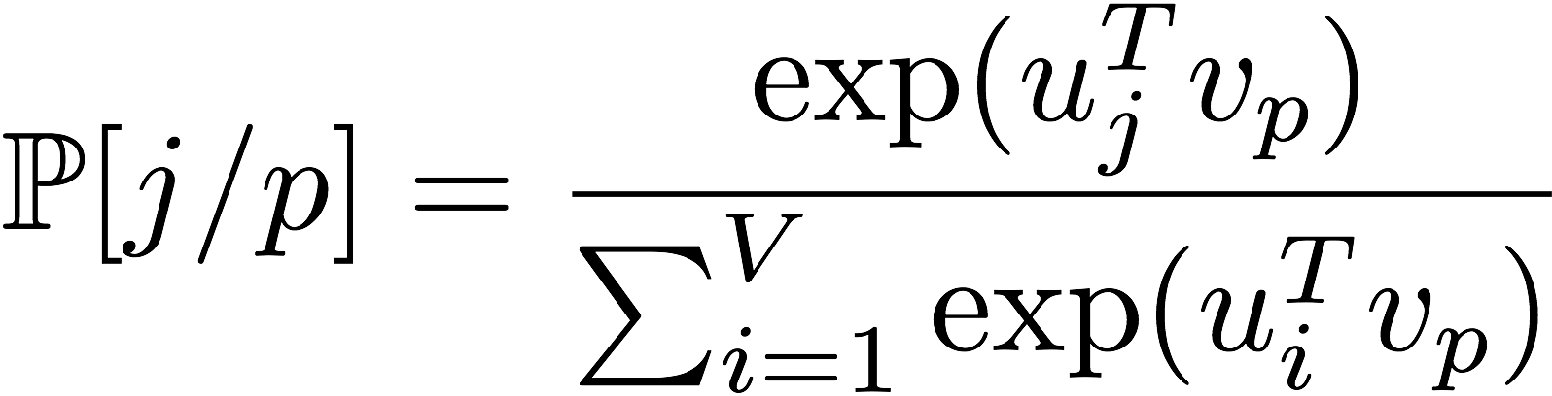
Continuous Bag of Words (Mikolov et al. 2013)
For each word we have v_{i} and u_{i}
y1
y2
y3
…
y_{V}
y
x1
x2
..
x_{v}
p1
p2
p3
…
p_{V}
h1
h2
..
h_{N}
W
W’
One hot-encoded of previous word

Slide 6
word2vec
For each word, its embedding captures the semantic geometry of the trained corpus.
u[ `Man’] is similar to u[‘suspect’]
(trained on news)

Slide 7
word2vec
Demo requires installing gensim and downloading GoogleNews-vectors-negative300.bin.gz pre-trained word2vec from https://code.google.com/p/word2vec/
w.most_similar('man')
[(u'woman', 0.7664012312889099), (u'boy', 0.6824870705604553), (u'teenager', 0.6586930751800537), (u'teenage_girl', 0.6147903203964233), (u'girl', 0.5921714305877686), (u'suspected_purse_snatcher', 0.571636438369751), (u'robber', 0.5585119724273682), (u'Robbery_suspect', 0.5584409832954407), (u'teen_ager', 0.5549197196960449), (u'men', 0.5489763021469116)]

Slide 8
From words to senses
Use a dictionary , for each word gives a definition string
vi -- di(1).. di(k)
each word is embedded as
word.pos.sense_num
Pos: n,v,a,r (noun,verb,article,adverb)
Sense_num: number indicating the count of the word.
The fifth noun sense of the word 'bank' is written as bank.n.5
Use a message passing algorithm that can be thought of as a simplified RNN computation to get an embedding for these senses.

Slide 9
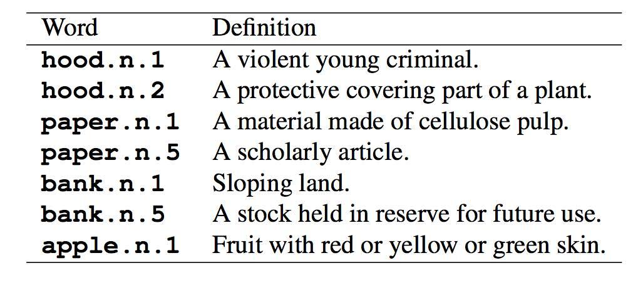
Using a Dictionary for Sense vs Word
Embedding Senses via Dictionary Bootstrapping by Kang et al.

Slide 10
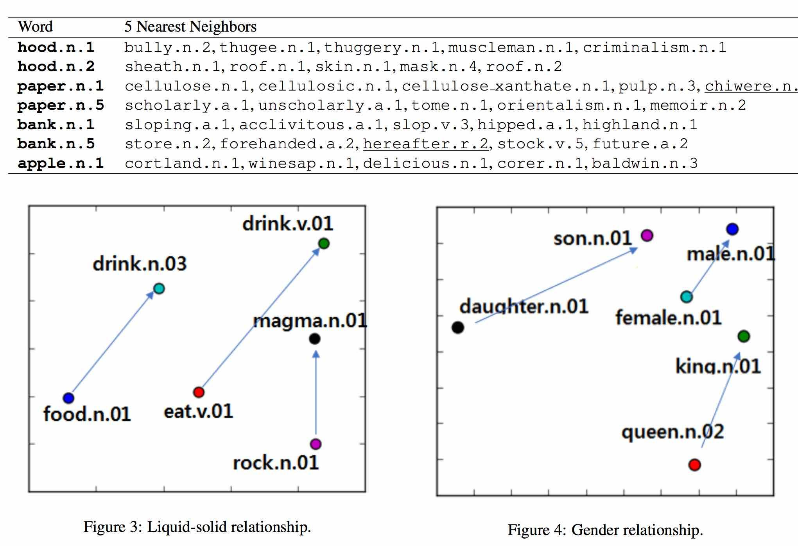
Embedding senses via Dictionary Bootstrapping

Slide 11
Using Transfer Learning
and Interpretability
Alex Dimakis
Nikolaos Vasiloglou

Slide 12
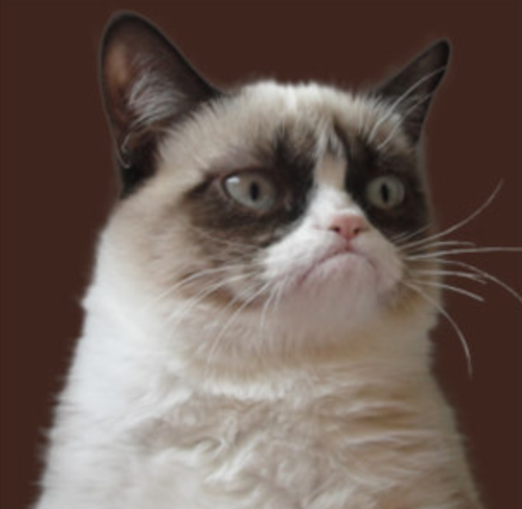
Get Inception V3 (massive pre-trained MLP)
Pr(cat) =0.7
Pr(banana) =0.01
Pr(grumpy) =0.2
...
Pr(dog) =0.02

Slide 13
Get Inception V3 (massive pre-trained MLP)
Trained on ImageNet.
Can recognize 1000 Class labels.
Trained on Millions of images,
Often better than typical human performance
Pr(cat) =0.7
Pr(banana) =0.01
Pr(grumpy) =0.2
...
Pr(dog) =0.02

Slide 14
Transfer Learning: How to leverage this power
https://research.googleblog.com/2016/03/train-your-own-image-classifier-with.html
Pr(cat) =0.7
Pr(banana) =0.01
Pr(grumpy) =0.2
...
Pr(dog) =0.02

Slide 15
Transfer Learning: How to leverage this power
https://research.googleblog.com/2016/03/train-your-own-image-classifier-with.html
Pr(cat) =0.7
Pr(banana) =0.01
Pr(grumpy) =0.2
...
Pr(dog) =0.02

Slide 16
Transfer Learning: How to leverage this power
https://research.googleblog.com/2016/03/train-your-own-image-classifier-with.html
Excellent image features.
Train a logistic regression on your problem.
Or an XGBoost classifier or any other model inside or outside TF.

Slide 17
Interpretability and Trust
``Why Should I Trust You?” Explaining the Predictions of Any Classifier.’’. Ribeiro et al. KDD 2016.
``Streaming Weak Submodularity: Interpreting Neural Networks on the fly.’’. (my group- uploaded on drive)
Problem: Given a black box model: ask
WHY did it give this label for this input.

Slide 18
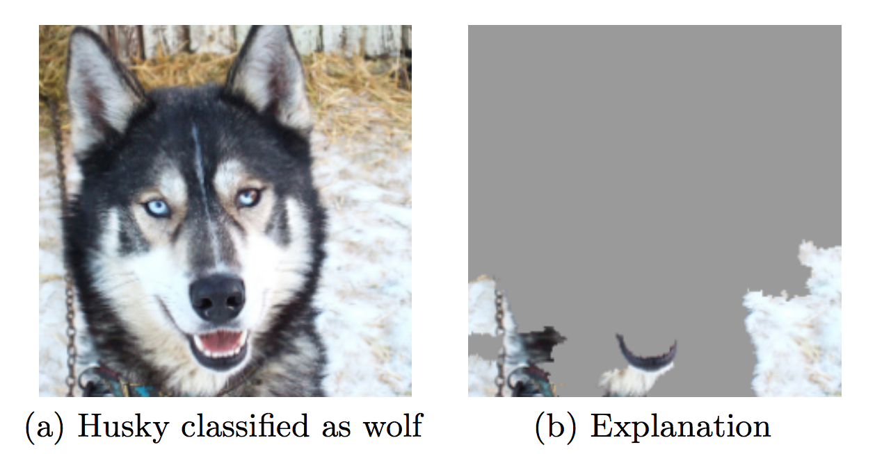
Interpretability and Trust
Interpretability is related to trust.

Slide 19
Interpretability and Trust
Interpretability is related to trust.
Malware detector had excellent accuracy over train-test split with true holdout.

Slide 20
Interpretability and Trust
Interpretability is related to trust.
Malware detector had excellent accuracy over train-test split with true holdout.
Was just checking if the code had comments.

Slide 21
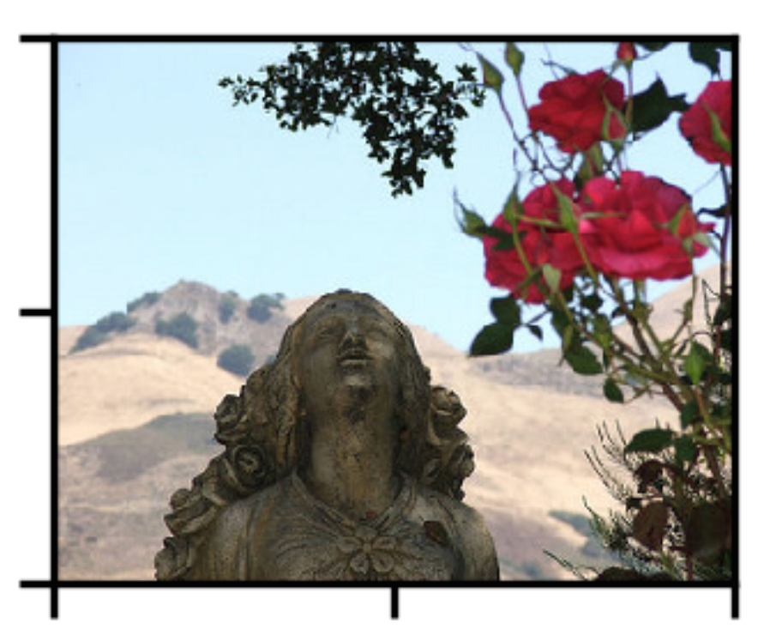
The idea:
R1
Segment image into regions
Feed subsets of the regions in the black box.
Black out the rest image.
Find which 3 regions maximize the likelihood of ‘Rose’
R2

Slide 22
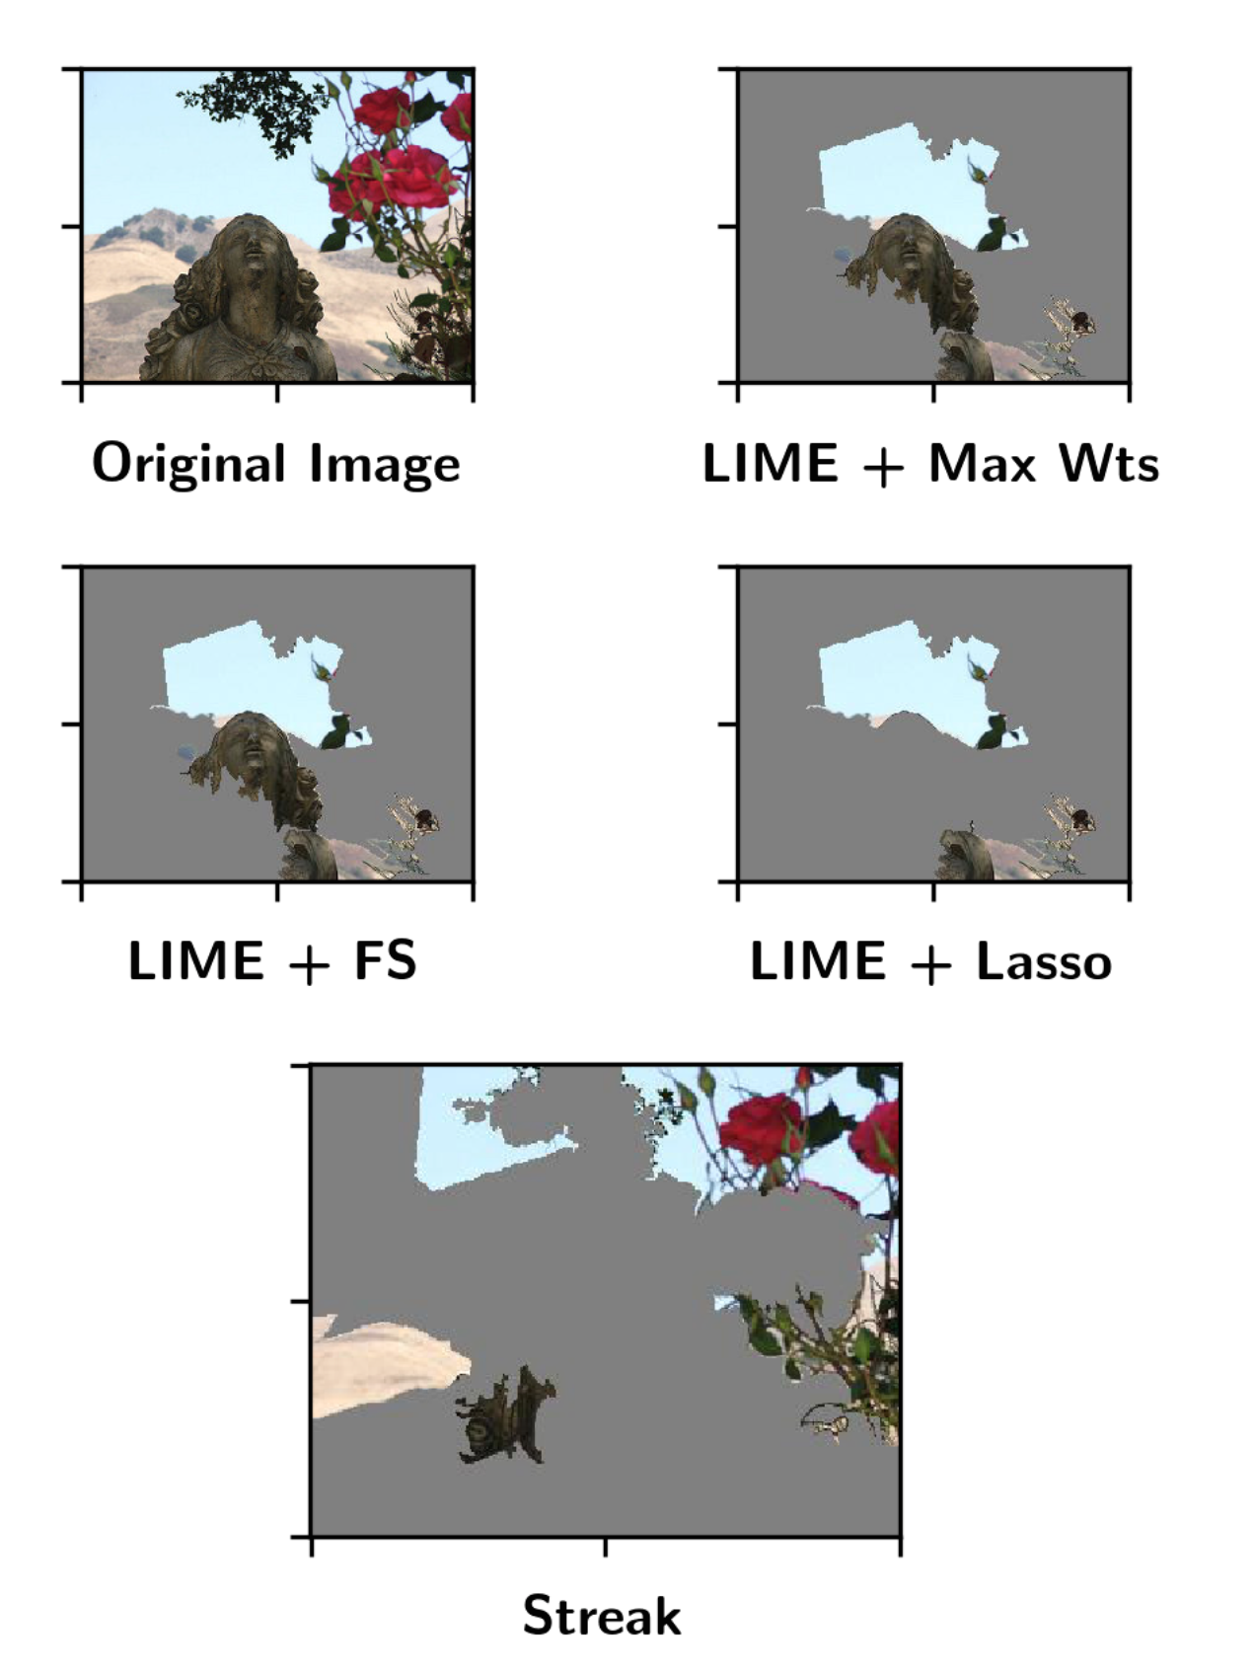
Lime and Streak

Slide 23
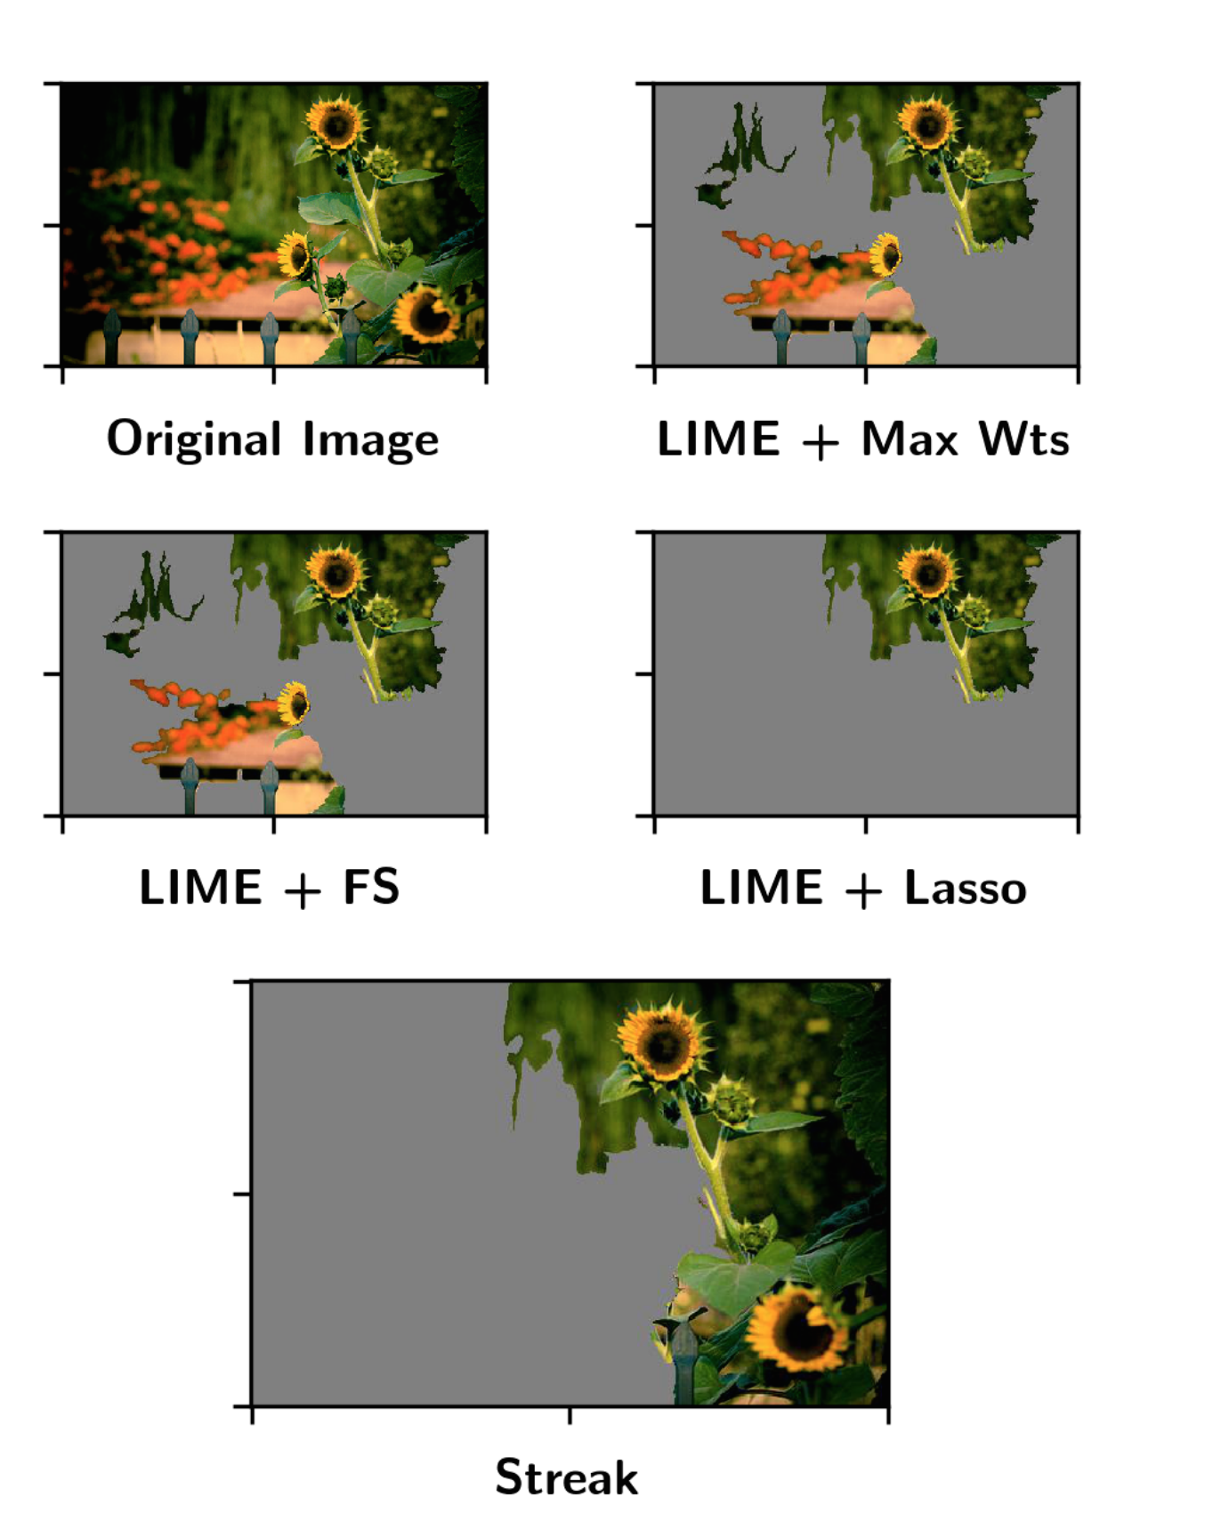
Lime and Streak

Slide 24
Interpretability and Trust
This is a very complex and hot topic in ML currently
Trusting for deployment
For scientific discovery

Slide 25
Interpretability and Trust
This is a very complex and hot topic in ML currently
Trusting for deployment
For scientific discovery
For Discrimination and Fairness

Slide 26
Interpretability and Trust
This is a very complex and hot topic in ML currently
Trusting for deployment
For scientific discovery
For Discrimination and Fairness
(e.g. Loan applications, Employment, News, ?)

Slide 27
Interpretability and Trust
This is a very complex and hot topic in ML currently
Trusting for deployment
For scientific discovery
For Discrimination and Fairness
(e.g. Loan applications, Employment, News, ?) Very interesting complex topic:
http://www.mlandthelaw.org/slides/hajian.pdf
http://www.mlandthelaw.org/ http://www.fatml.org/resources

